Slide 1

DATE :03/0721
AI in Energy
DISCLAIMER: This document is strictly private, confidential and personal to its recipients and should not be copied, distributed or reproduced in whole or in part, nor passed to any third party.

Slide 2
Data Modelling
This section explains the clustering technique used for the data modelling and prior steps taken to building the model. It follows a data science workflow.

Slide 3
Methodology
Data collection
Exploratory Data Analysis
Feature engineering
Feature selection
Feature scaling
Model building
Model evaluation
Cluster labelling
:

Slide 4
Data Collection
The data was rightfully collected and compiled from the data gathering team
It was retrieved from the GitHub repo and can be accessed here
https://github.com/OmdenaAI/omdena-nigeria-energy/blob/main/src/final%20deliverables/Dataset_final/Nighttime_and_population_data.csv

Slide 5
Exploratory Data Analysis
The dataset contains 774 samples and 11 features names:
LGA
Average Nighttime mean
Area
State
System Index
Area
State
Latitude
Longitude
Perimeter
Population

Slide 6
Exploratory Data Analysis (Contd’)
13724250
There were 774 LGAs in the country with 36 states the states having a minimum of 6 LGAs and a maximum of 44 LGAs
The LGA had an average land area of 1173. 07 square kilometer with 75% of the LGAs having a land area less than 1519.81 square kilometer.
The minimum and maximum land area coverage of the LGAs are 11.65 and 10357.67 square kilometer respectively.
Kano appears to be the most populated state with 13,724,250 residents, while Bayelsa is the least populated state having 1,099,952 residents.
Lagos state has the highest Average Nighttime light mean of 159.433944 as was expected while Bauchi state has the least Average Nighttime light mean of 0.052742.

Slide 7
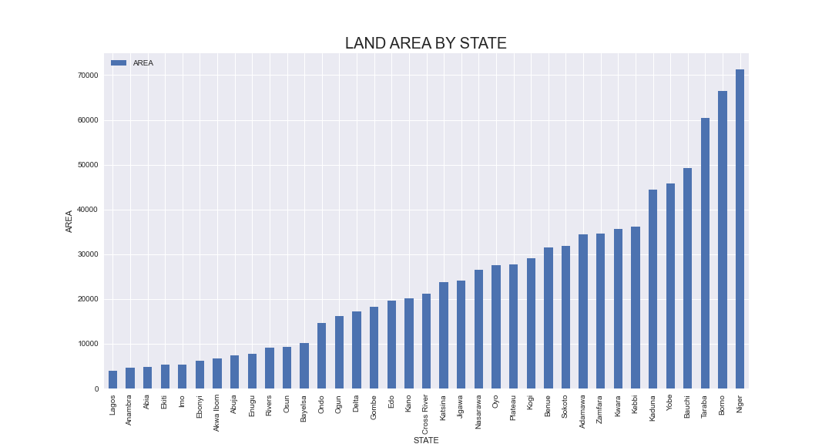
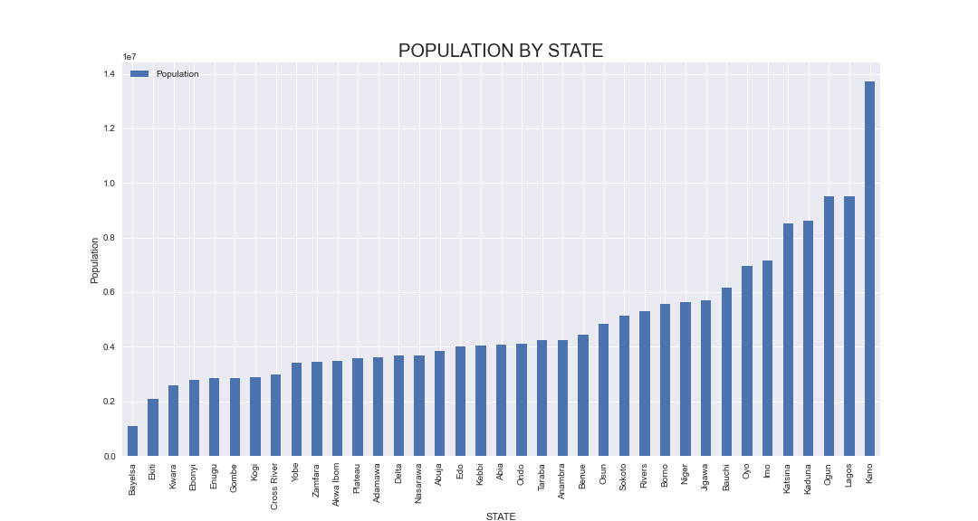
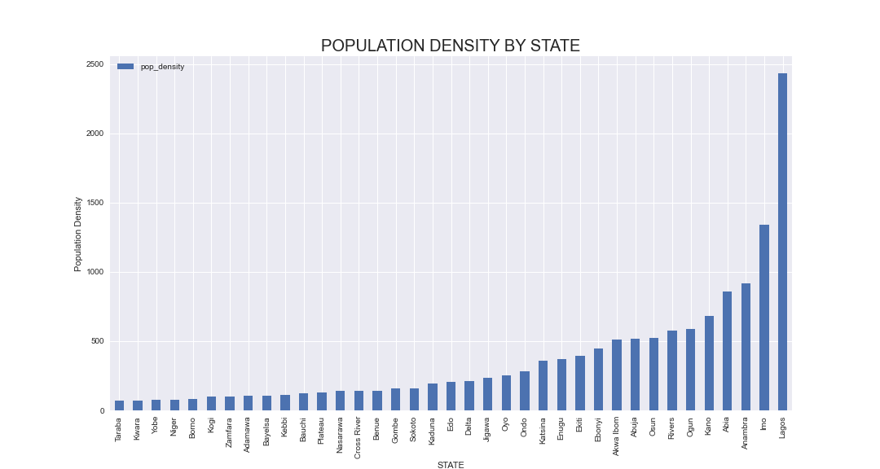
Exploratory Data Analysis (Contd’)

Slide 8
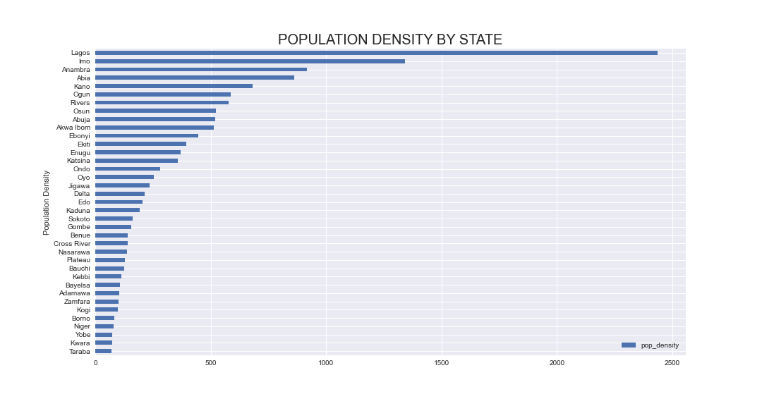
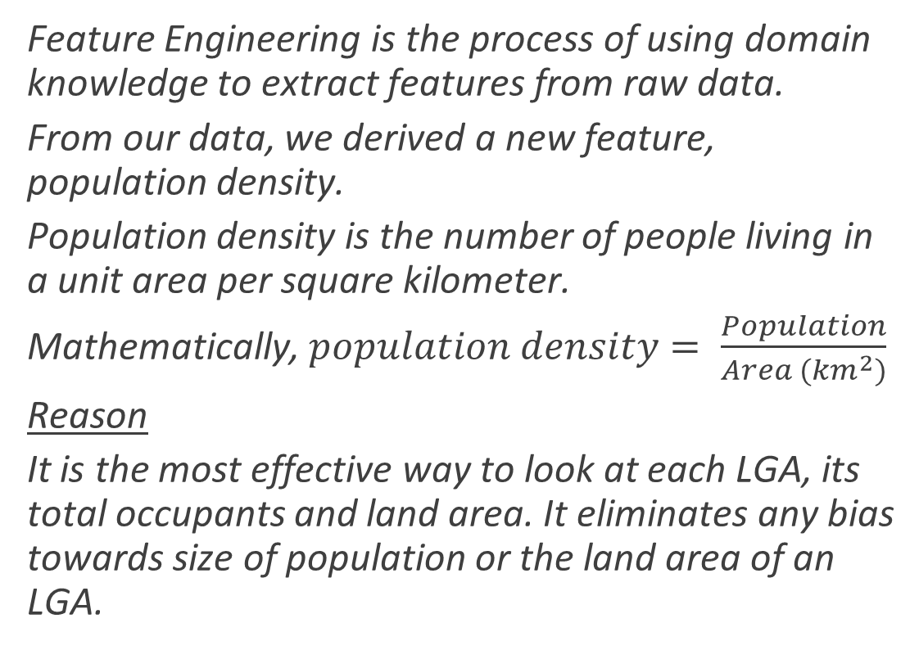
Feature Engineering
Feature Engineering is the process of using domain knowledge to extract features from raw data.
From our data, we derived a new feature, population density.
Population density is the number of people living in a unit area per square kilometer.
Mathematically, $population density= \frac{Population}{Area ({km}^{2})}$
Reason
It is the most effective way to look at each LGA, its total occupants and land area. It eliminates any bias towards size of population or the land area of an LGA.

Slide 9
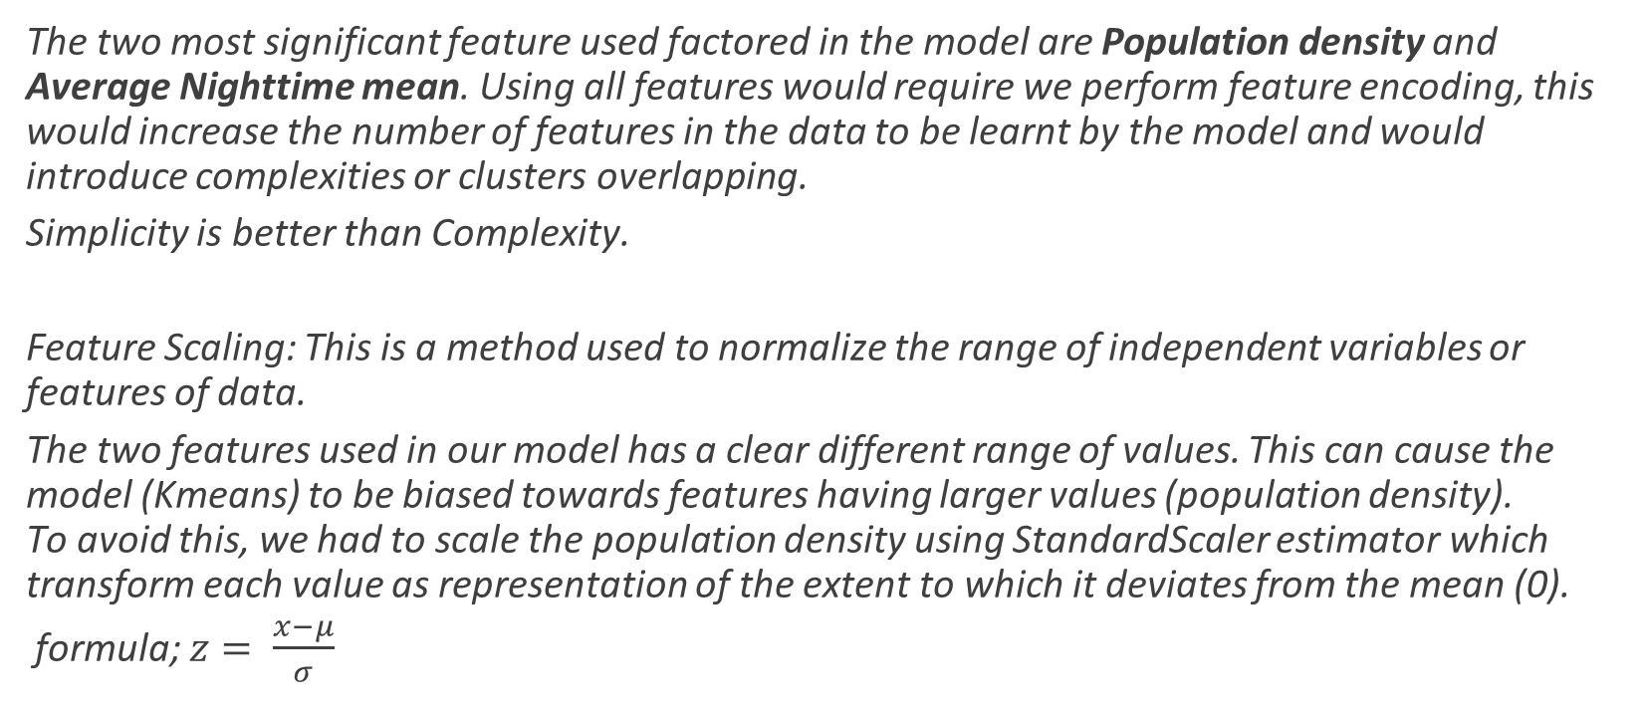
Feature Selection and Scaling
The two most significant feature used factored in the model are Population density and Average Nighttime mean. Using all features would require we perform feature encoding, this would increase the number of features in the data to be learnt by the model and would introduce complexities or clusters overlapping.
Simplicity is better than Complexity.
Feature Scaling: This is a method used to normalize the range of independent variables or features of data.
The two features used in our model has a clear different range of values. This can cause the model (Kmeans) to be biased towards features having larger values (population density). To avoid this, we had to scale the population density using StandardScaler estimator which transform each value as representation of the extent to which it deviates from the mean (0).
formula; $z= \frac{x−μ}{σ}$

Slide 10
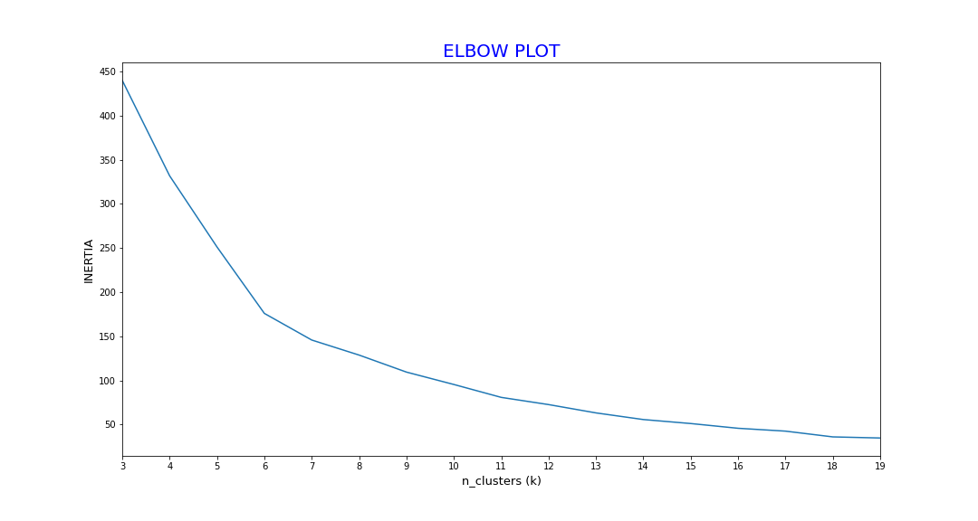
Model Building
The model used was Kmeans. It is a distance-based algorithm that tries to partition the dataset into K pre-defined distinct non-overlapping subgroups (clusters) where each data point belongs to only one group.
Prior to the instantiating the model and setting a pre-defined K clusters, an elbow plot was used to check for the optimal k clusters for the data the model was to learn from.
Although the optimal clusters for the data suggested by the elbow plot seems to fall around 11, we choose to settle for 5 clusters, the reason behind this was to avoid too many cluster as having too much clusters would mean resources would be pulled for several sections. This would require more labor and different procedures for the installation the solar panels at strategic positions.

Slide 11
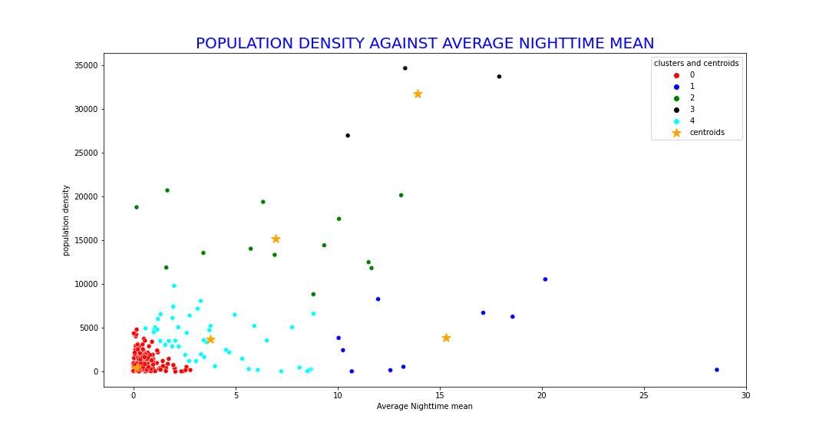
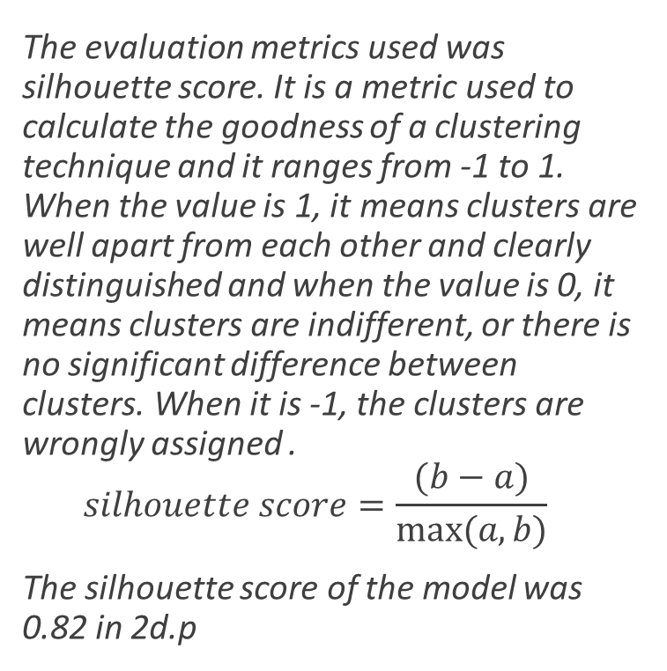
Model Evaluation
The evaluation metrics used was silhouette score. It is a metric used to calculate the goodness of a clustering technique and it ranges from -1 to 1. When the value is 1, it means clusters are well apart from each other and clearly distinguished and when the value is 0, it means clusters are indifferent, or there is no significant difference between clusters. When it is -1, the clusters are wrongly assigned .
$$silhouette score=\frac{(b−a)}{max⁡(a,b)}$$
The silhouette score of the model was 0.82 in 2d.p

Slide 12
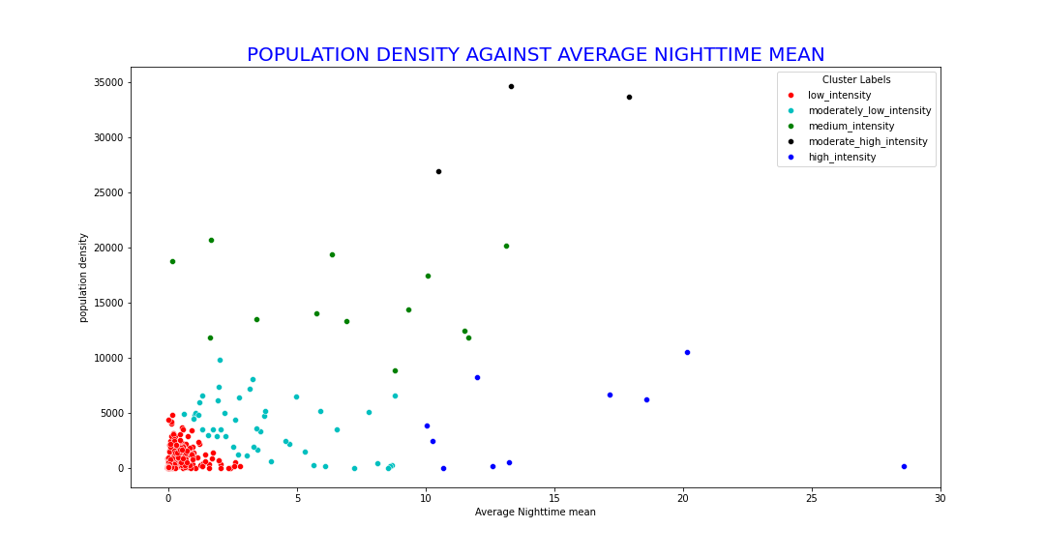
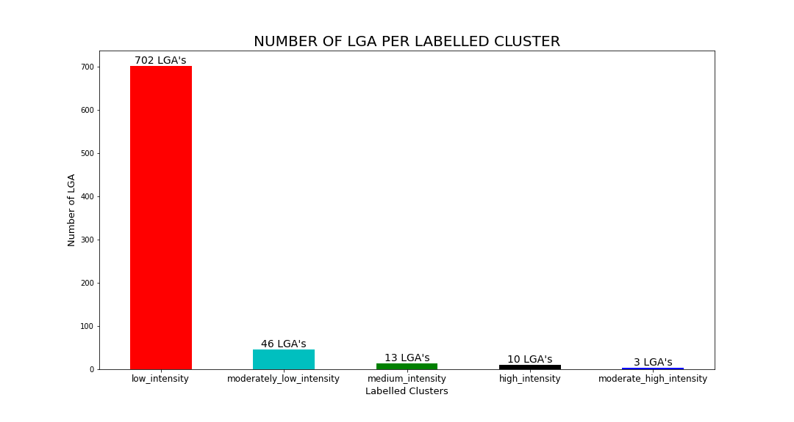
Cluster Labelling
The clusters generated by the model were renamed based on how much luminous intensity they emit.
From least luminous intensity to the most;
low intensity, moderately low intensity, medium intensity, moderate high intensity, high intensity.
During solar panel installation, LGAs that fall within low intensity cluster are placed as topmost priority while LGAs within the high intensity cluster are placed last.

Slide 13
Conclusion
Kmeans clustering algorithm was used in modelling with a pre-defined clusters of 5. Although, the elbow plot suggested an optimal clusters of 11, the chosen clusters was set so as to avoid too many clusters which would cause an increase in resources to be designated to those subgroups (clusters). The model had a silhouette score of approximately 0.82 upon evaluation signifying clear and distinguished clusters.
The clusters were labelled from least luminous intensity to the most in the order; low intensity, moderately low intensity, medium intensity, moderate high intensity, high intensity. With low intensity being top on solar panel installation and high intensity coming last.

Slide 14
Active Collaborators
Nnaemeka, Emmanuel Uchenna
David Obembe
All that attended the brainstorm sessions

Slide 15
Appendix
Raw data used
https://github.com/OmdenaAI/omdena-nigeria-energy/blob/main/src/final%20deliverables/Dataset_final/Nighttime_and_population_data.csv
Jupyter notebook for EDA
https://github.com/OmdenaAI/omdena-nigeria-energy/blob/main/src/final%20deliverables/task/Data_Modeling/Explainatory%20Data%20Analysis.ipynb
Jupyter notebook for data modelling
https://github.com/OmdenaAI/omdena-nigeria-energy/blob/main/src/final%20deliverables/task/Data_Modeling/Omdena%20cluster%20model.ipynb

